Slide 1
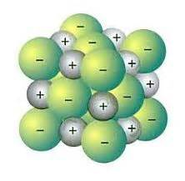
Ionic Compounds
A COMPOUND CONSISTING OF POSITIVE AND NEGATIVE IONS
METAL + Non-MetaL
The sum of the charges should equal zero

Slide 2
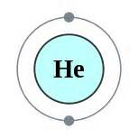
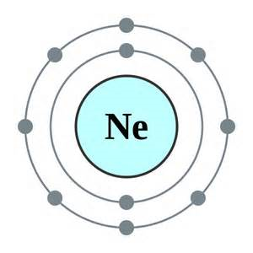
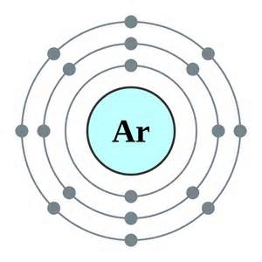
When do Elements form compounds?
Unstable elements form compounds
Stable elements do not combine easily with other elements, they are happy
Stable Elements have fully filled outer orbits

Slide 3
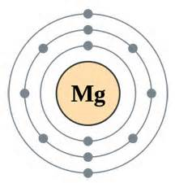
Unstable Elements

Slide 4
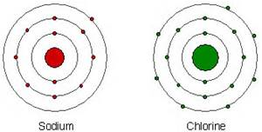
How do unstable elements become happy?
Combine sodium and Chlorine
They gain or lose electrons, so their outer orbit is full.
Valence electrons- electrons in the outer orbit

Slide 5
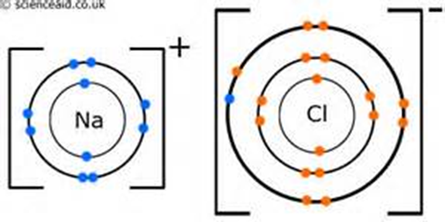
Sodium Chloride

Slide 6
Rules for Naming Binary IONIC COMPOUDS
Metal is written first, no changes
Non-metal is second, change ending to –ide.
*** the sum of the charges must equal zero!

