Slide 1
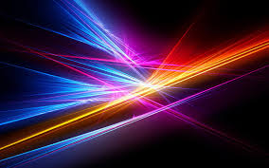
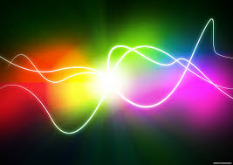
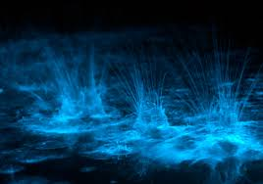
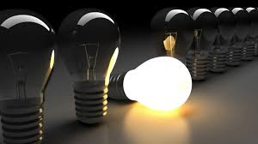
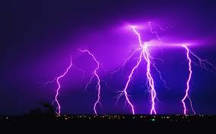
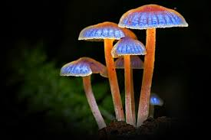
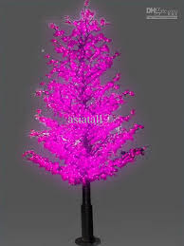
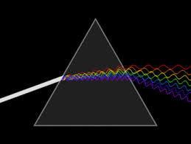
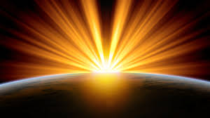
Sources of Light

Slide 2
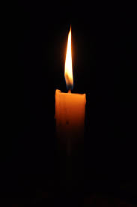
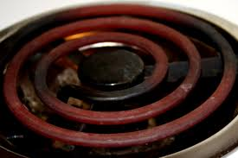
Incandescent Light
The production of light as a result of high temperatures
ie. burner on a stove, candle and incandescent light bulb

Slide 3
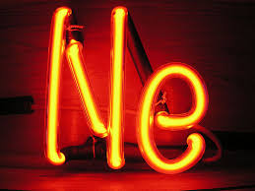
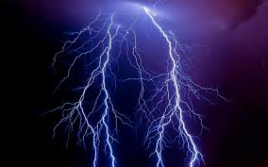
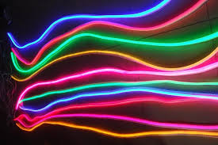
Electric Discharge
Produced by an electric current passing through a gas
ie. Iightning, neon gas (red light)

Slide 4
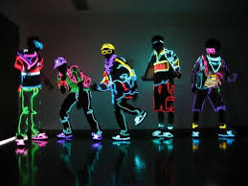
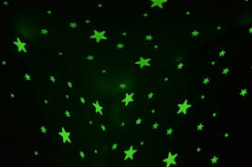
Phosphorescence
Producing light by absorbing ultraviolet light (UV) resulting in the emission of visible light over an extended period of time
ie. glow in the dark materials
(coated with phosphors)

Slide 5
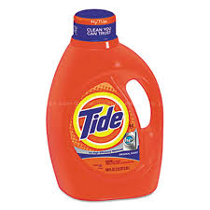
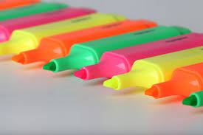
Fluorescence
An object absorbs ultraviolet light and immediately releases the energy as visible light
ie. fluorescent lights (tube is filled with mercury vapour, the electrical current causes the mercury atoms to emit UV light),
detergents, highlighters, use fluorescent dyes to brighten

Slide 6
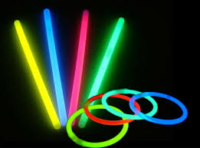
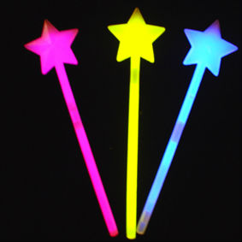
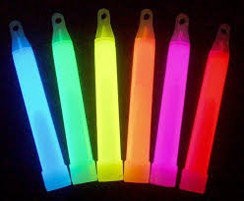
Chemiluminescence
The direct production of light as the result of a chemical reaction with little or no heat produced
ie. glow stick

Slide 7
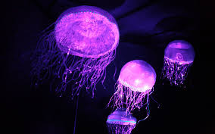
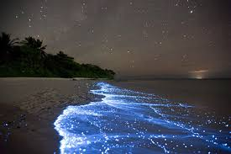
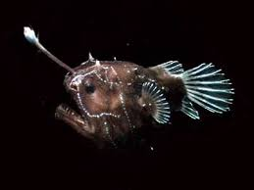
Bioluminescence
the production of light in living organisms as the result of a chemical reaction with little or no heat produced
ie. firefly (chemical reaction of oxygen & luciferin, a substance in the lower abdomen)

Slide 8
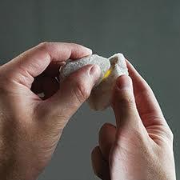
Triboluminescence
Production of light when certain crystals are scratched, crushed or rubbed
ie. Quartz

Slide 9
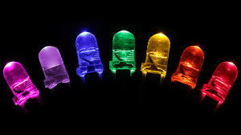
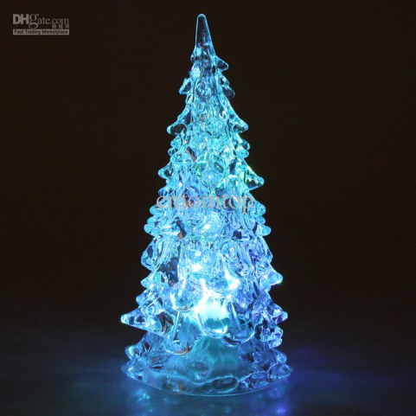
Light Emitting Diode LED
Light production as a result of an electric current flowing in semi-conductors (flows in one direction)
This does not produce much heat as a by-product and is more energy efficient
ie. Christmas lights, traffic lights

